Slide 1
The Architecture of the
Traditional Islamic Madrasas in the Old City of Aleppo
(A comparative analytical study)

Slide 2
Introduction of the researcher
Architect /Private University of Science & Arts (P.U.S.A) in Aleppo
Master’s degree in architecture (Restoration and Conservation of Historical Monuments) from Bahcesehir University in Istanbul
Awardee of the stewards of Cultural Heritage Project at the German Archaeological Institute in Istanbul since October 2016
© DGAM

Slide 3
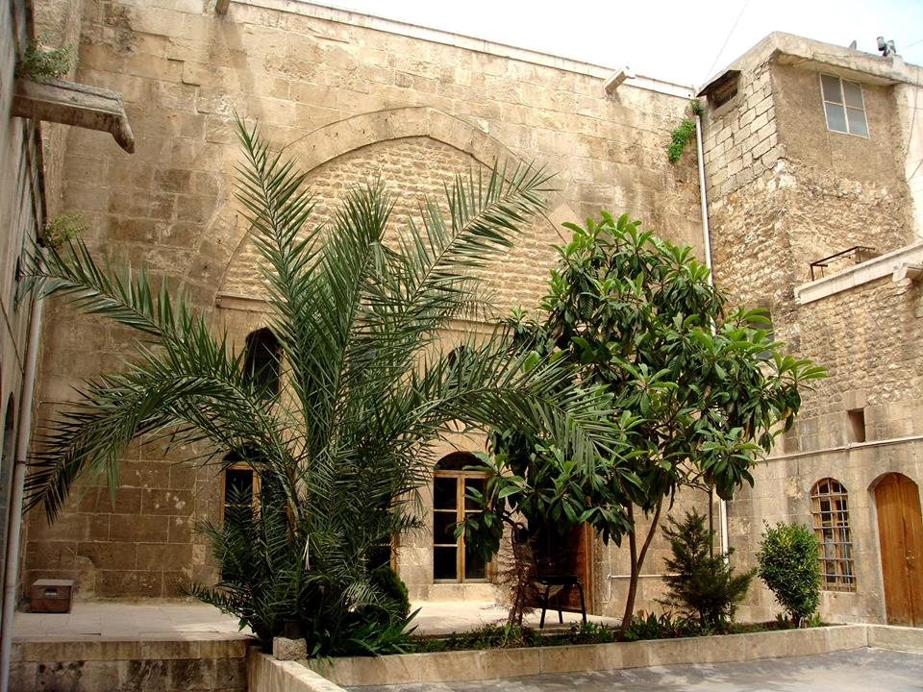
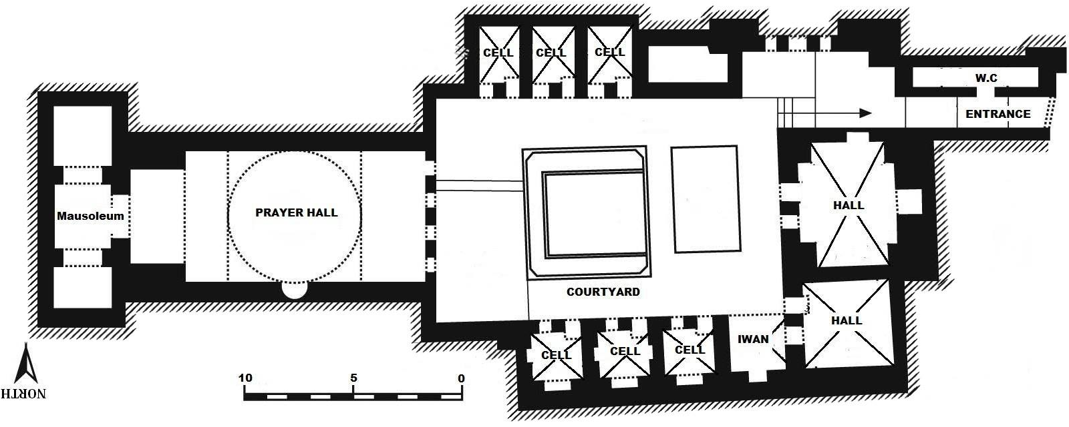
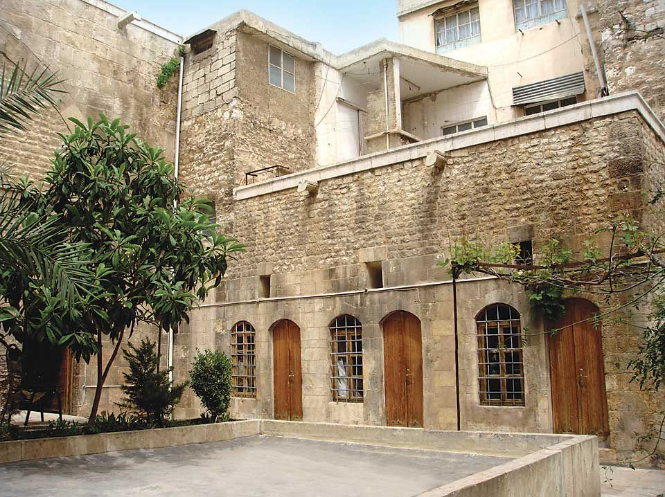
Definition of Madrasa
Madrasa is an Arabic word which means school or a place for learning (Ahunbay, 2000, p. 338).
Madrasas were established by a governor or charities and operated through WAQF.
The main purpose of the madrasa was to teach Islamic principles such as religious sciences and applied sciences such as logic, philosophy, mathematics, and astronomy science.
Figure 1: plan of madrasa al Asadiyya, Aleppo
N
1:300
Source: Jasser.(1999).Historical Madrasas of Aleppo, Dar Al-Radwan, Aleppo. plan of madrasa al Asadiyya, Aleppo Figure 42 Aleppo .madrasa al –Asadiyya plan 128..
Source: Arabic Encyclopaedia, View of cells. 2011. Aleppo

Slide 4
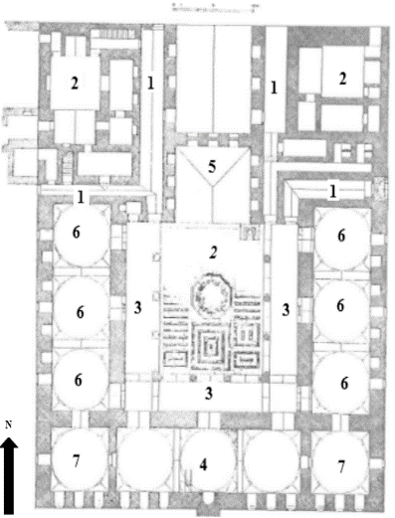
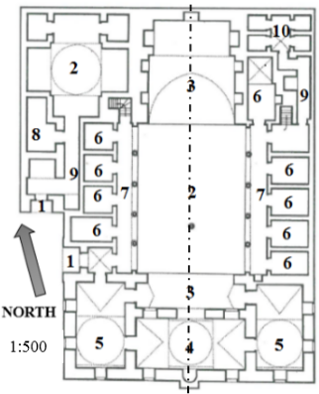
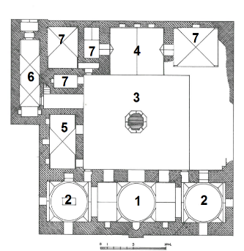
The project
Comprehensive study of Madrasas during Islamic period of Aleppo (Zinged, Ayyubid, and Mamluk,), through presenting historical information and architectural description of madrasas.
Firdaws
Adimiyya
Kamaliyya
N
1:1000
1:1000
1:1000
Source: https://archnet.org/sites/1808/media_contents/44550.

Slide 5
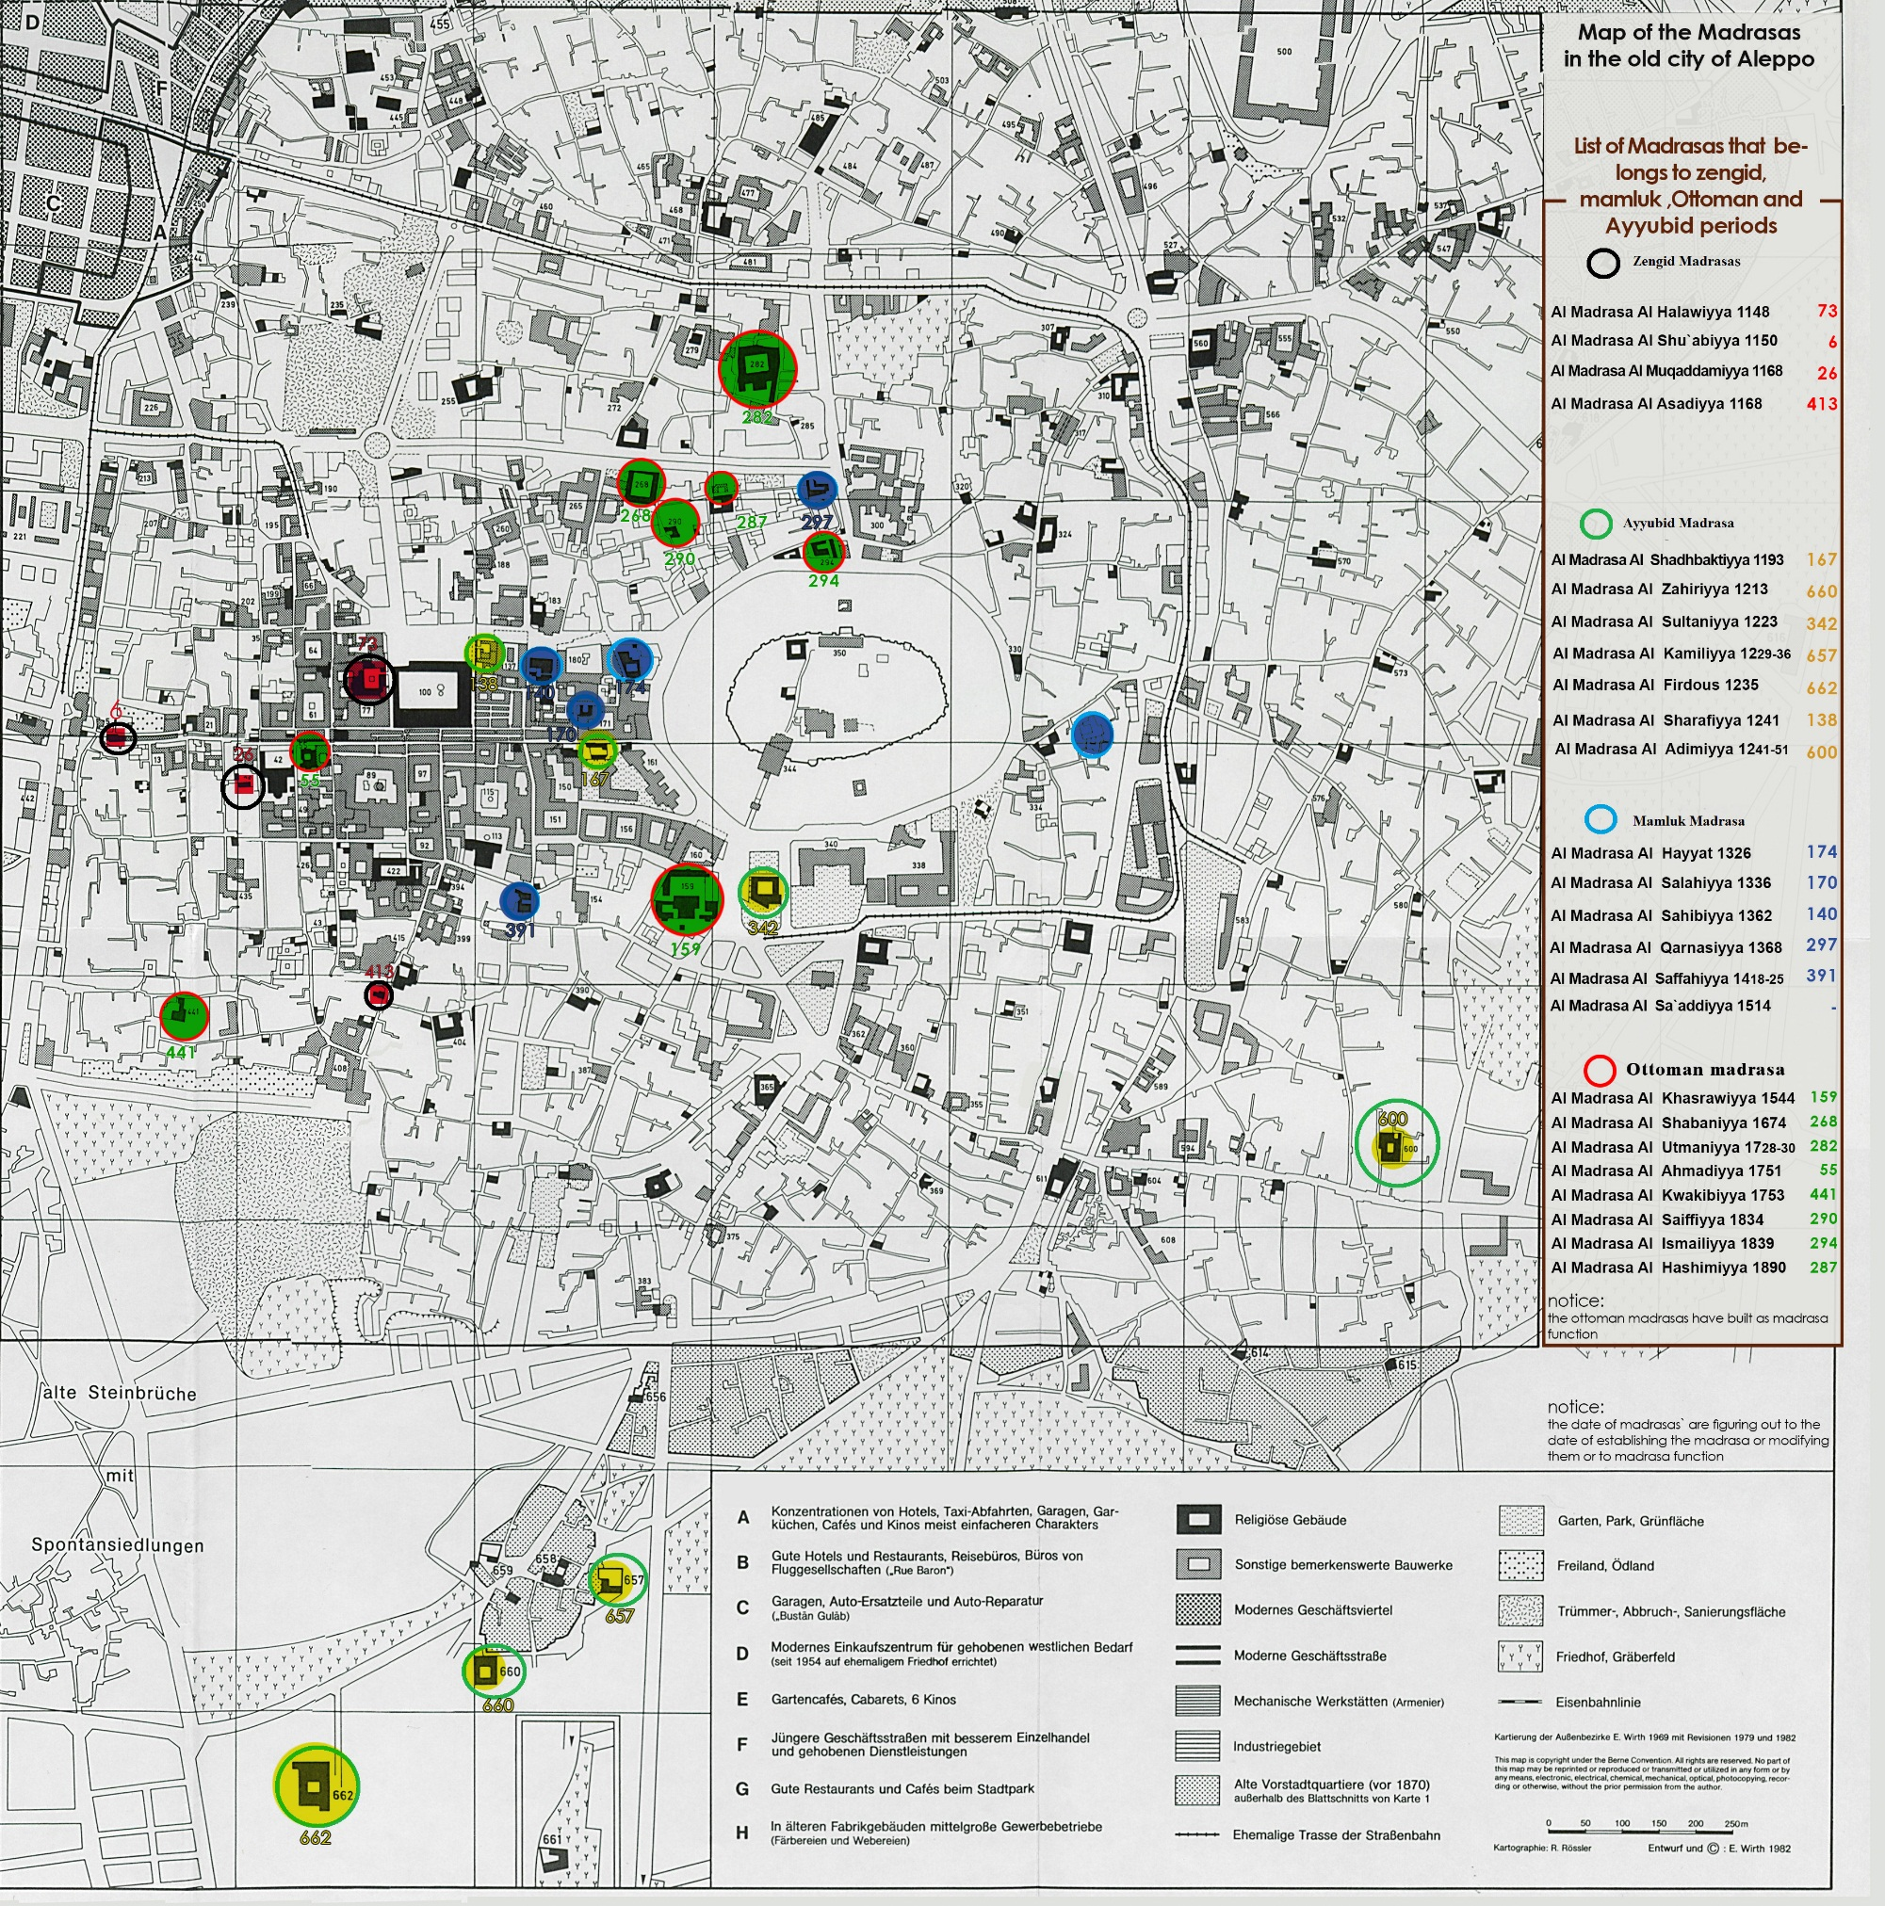
Location of Aleppo madrasas during Zinged, Ayyubid, Mamluk,and Ottoman periods
N
1:20000
Source: Gaube-Wirth_Kartenlegenden, modified by Mouhanad Aboudan.

Slide 6
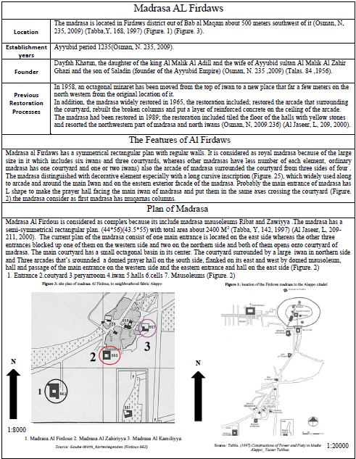
Catalogue

Slide 7
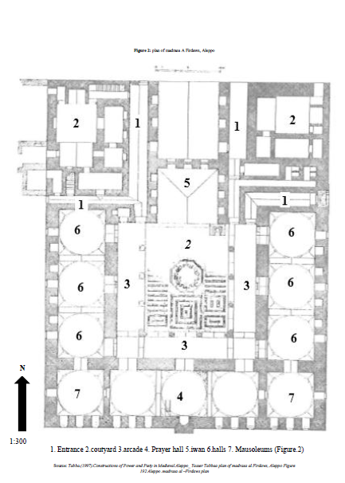
Catalogue

Slide 8
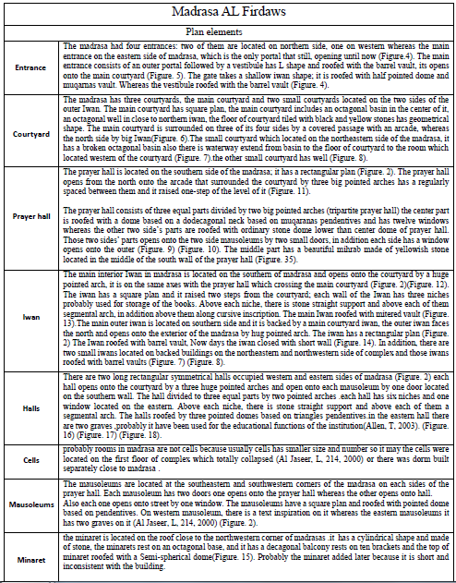
Catalogue

Slide 9
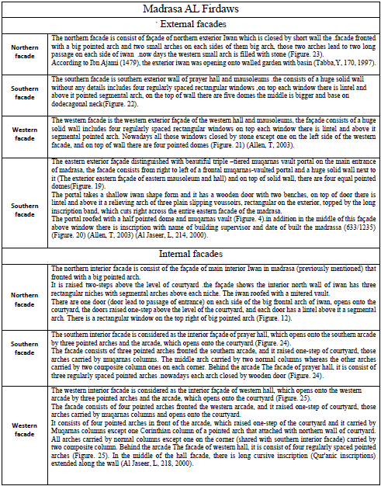
Catalogue

Slide 10
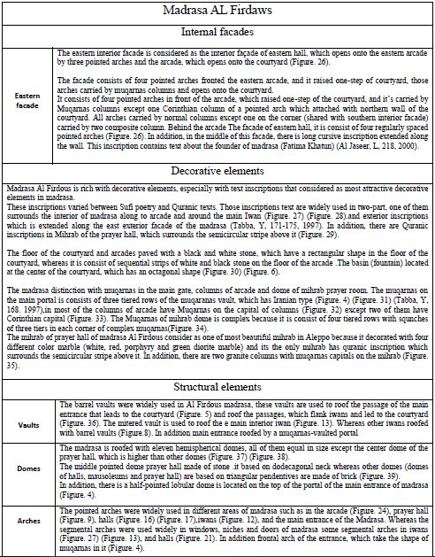
Catalogue

Slide 11
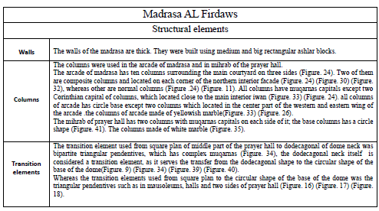
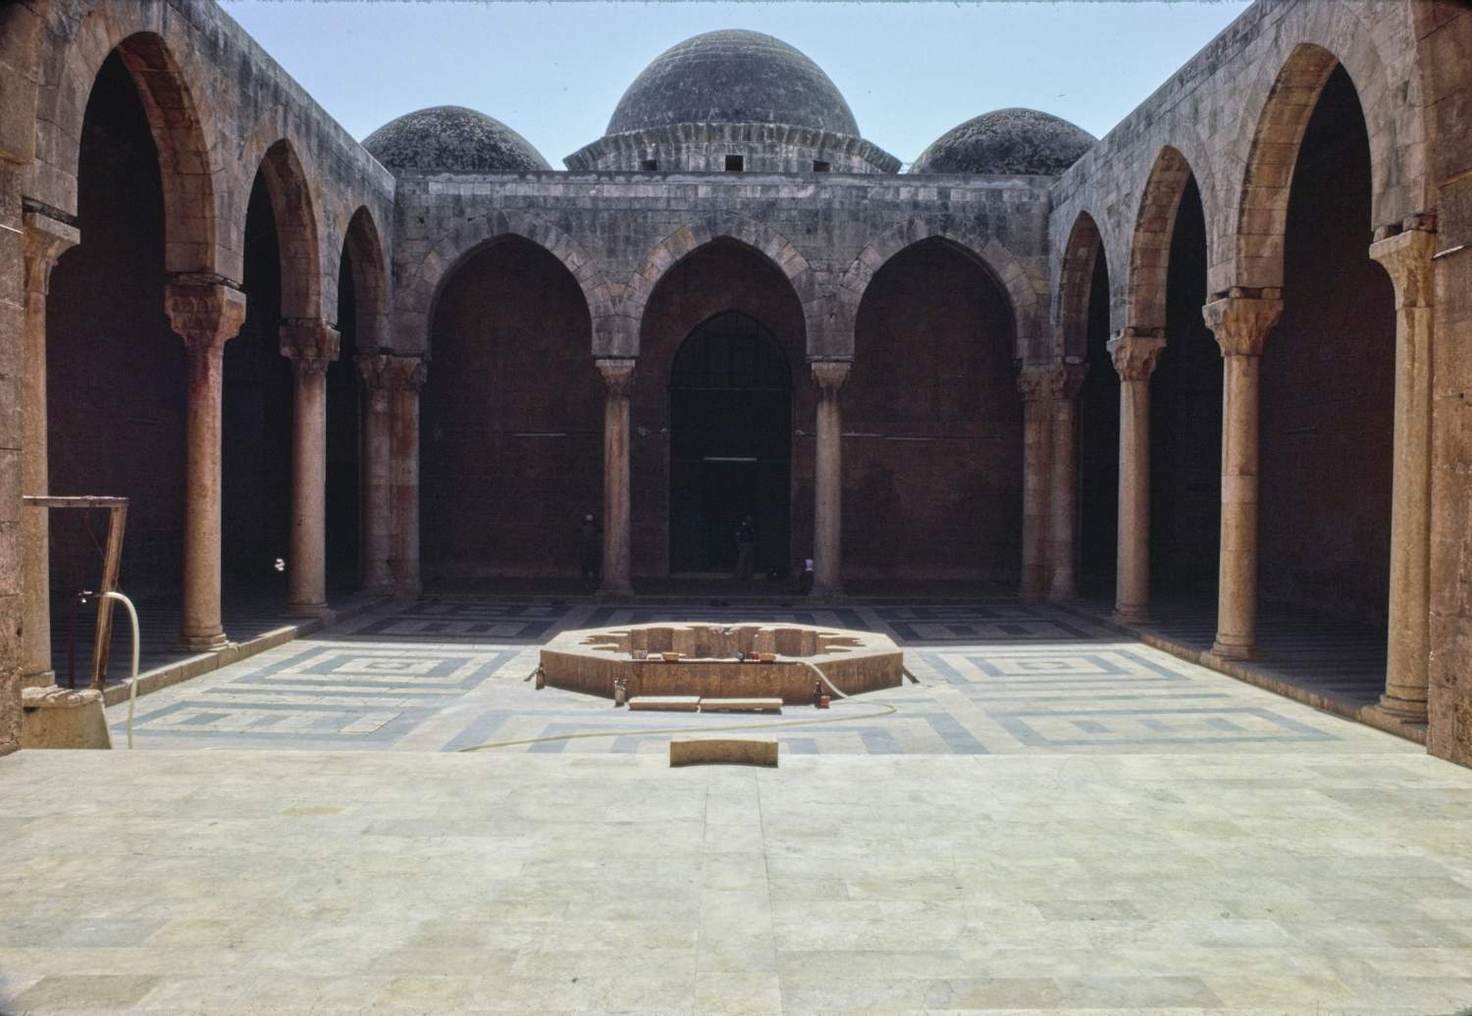
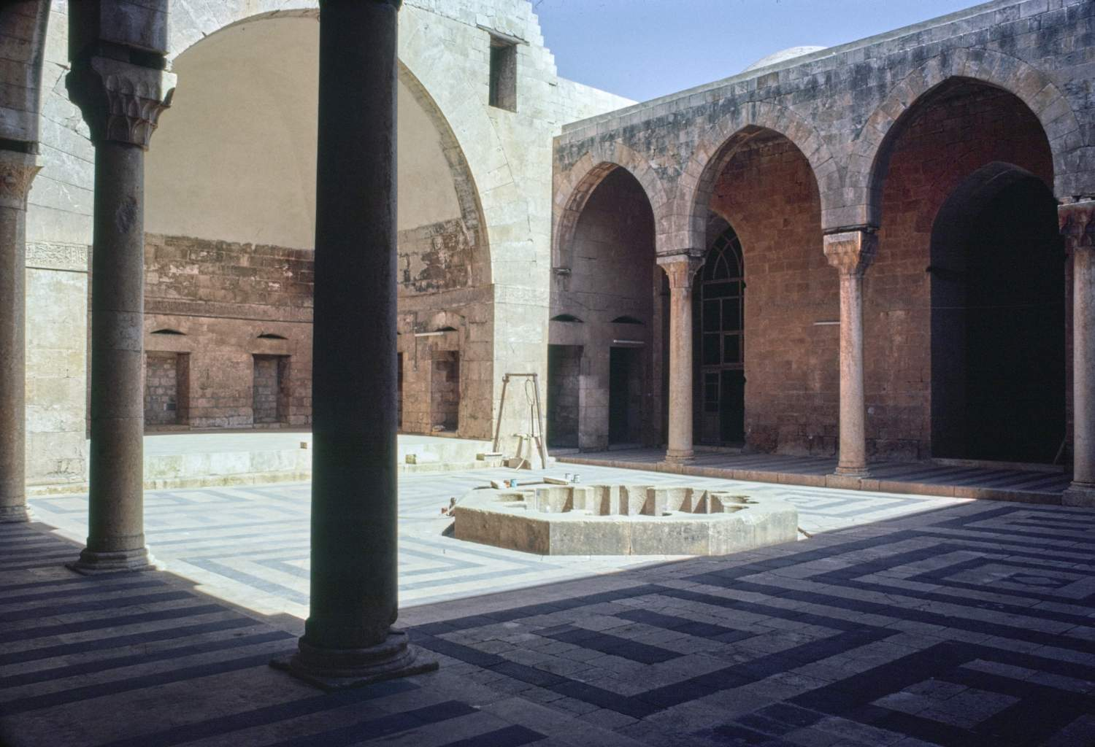
Catalogue
Source: Archnet, view of southern interior facade of madrasa Firdows, Aleppo1979
Source: Archnet, Courtyard, view toward northeast corner of Firdows, Aleppo1979

Slide 12
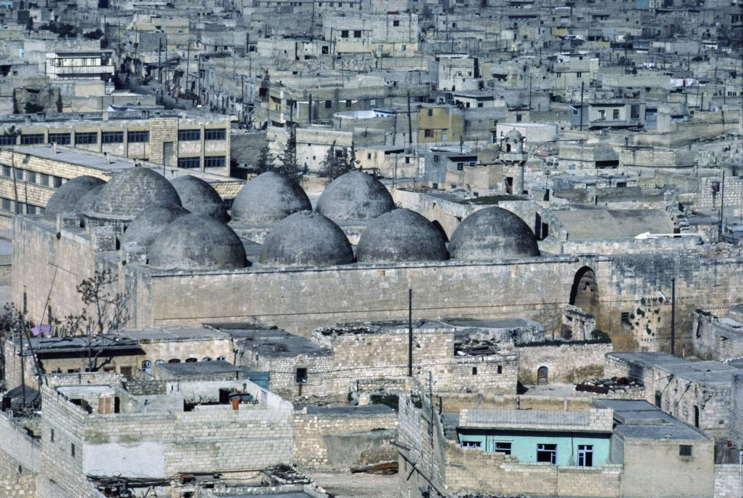
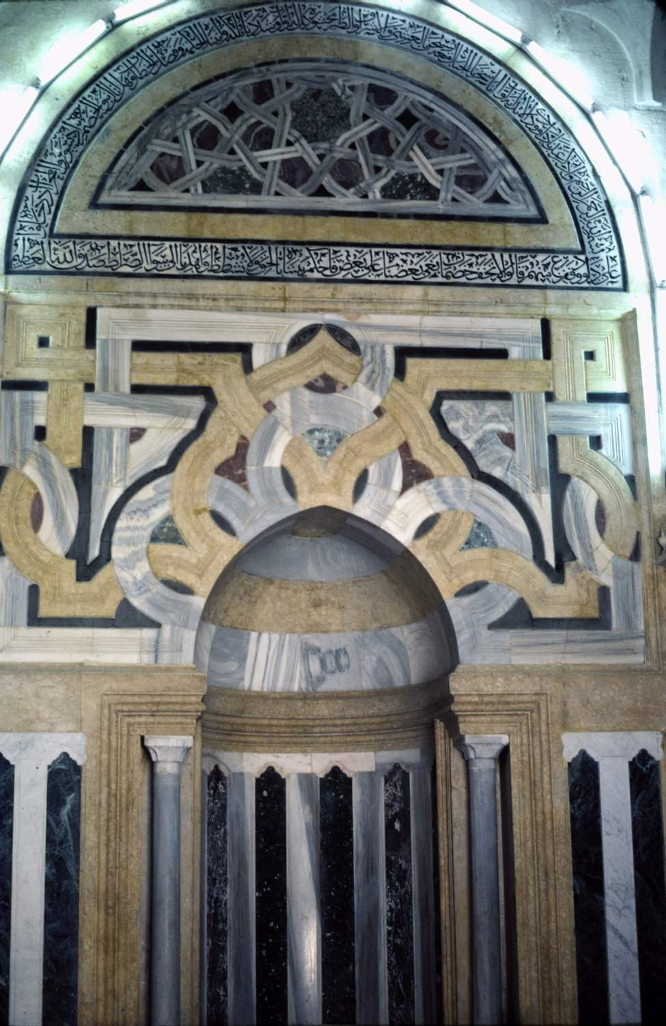
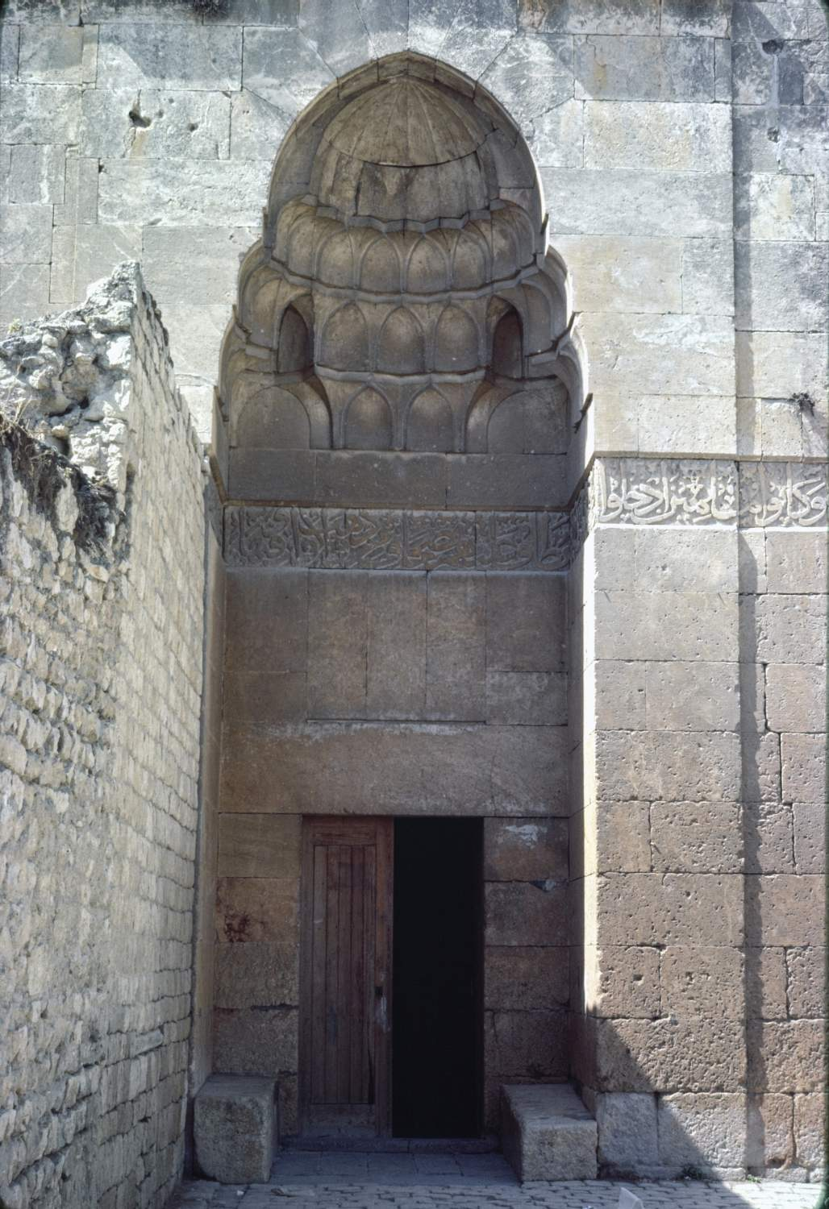
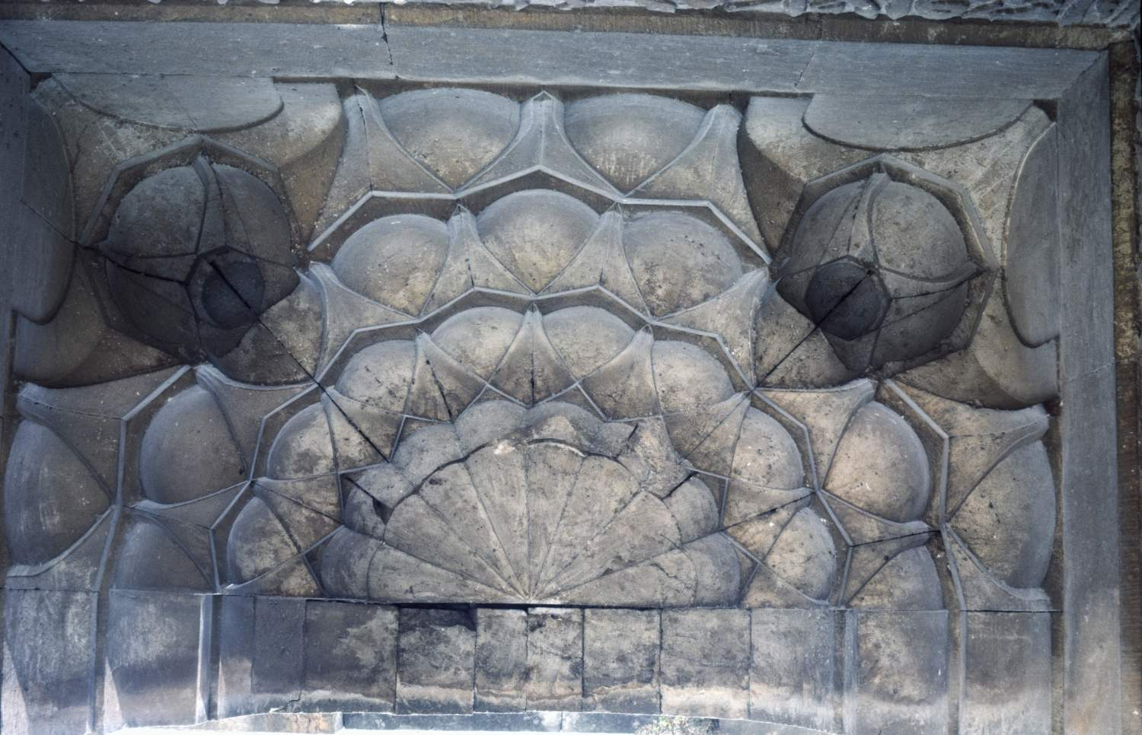
Source: Archnet,, Distant view over complex from southeast.,Firdows, Aleppo1986
Source: Archnet,, view of Portal, of main entrance Firdows, Aleppo1984
Source: Archnet,, view of Mihrab of prayer hall,, Aleppo1980
Source: Archnet,, Portal, view of muqarnas vault of main entrance Firdows, Aleppo1980

Slide 13
Location of Aleppo madrasas during Zinged, Ayyubid, Mamluk,and Ottoman periods
N
1:20000
Source: Gaube-Wirth_Kartenlegenden, modified by Mouhanad Aboudan.

Slide 15
Thank you for your attention

